Slide 1
HERS: Modeling Influential Contexts with Heterogeneous Relations for Sparse and Cold-start Recommendation
Liang Hu^{1,2}, Songlei Jian^{1,3}, Longbing Cao¹ , Zhiping Gu⁴, Qingkui Chen², Artak Amirbekyan⁵
¹University of Technology Sydney
²University of Shanghai for Science and Technology
³National University of Defense Technology
⁴Shanghai Technical Institute of Electronics Information
⁵Commonwealth Bank of Australia

Slide 2
Outline
Heterogeneous Relations in Recommender Systems
Modeling HERS with Influential Context Units
Experiment Details
Conclusion and Future Direction

Slide 3
Outline
Heterogeneous Relations in Recommender Systems
Modeling HERS with Influential Context Units
Experiment Details
Conclusion and Future Direction

Slide 4
Why modeling heterogeneous relations in RS?
The basic problem in RS is to study the user-item relation.
Besides user-item relation, user-user relation (e.g. social network) and item-item relation (e.g. compatibility)
In fact, user-user relation and item-item relation have direct influence on user selection, so they should be considered when modeling RS.

Slide 5

Influence contexts for making decision
A user $u$ is influenced by friends and friends' friends. $C_{u}$ signifies the user influential context.
User selection on an item $i$is also influenced by relevant items which form item influential context $C_{i}$.
Influential contexts of users and items indicate how a user's choice on items is made, thus making recommendation more accurate and interpretable.

Slide 6
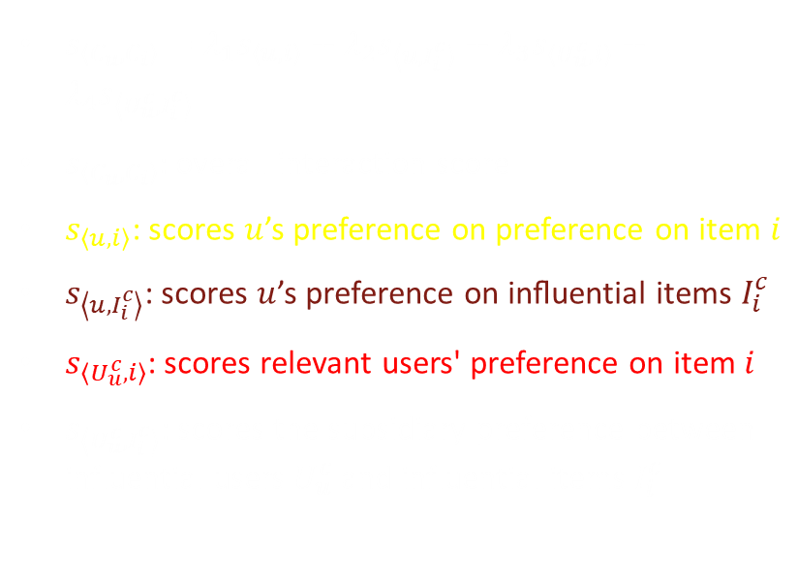
Influential context interaction decomposition
$s_{\left\langle C_{u},C_{i}\right\rangle }=λ_{1}s_{\left\langle u,i\right\rangle }+λ_{2}s_{\left\langle u,I_{i}^{c}\right\rangle }+λ_{3}s_{\left\langle U_{u}^{c},i\right\rangle }+λ_{4}s_{\left\langle U_{u}^{c},I_{i}^{c}\right\rangle }$
$s_{\left\langle C_{u},C_{i}\right\rangle }$: overall interaction score
$s_{\left\langle u,i\right\rangle }$: scores $u$’s preference on preference on item $i$
$s_{\left\langle u,I_{i}^{c}\right\rangle }$: scores $u$’s preference on inﬂuential items $I_{i}^{c}$
$s_{\left\langle U_{u}^{c},i\right\rangle }$: scores relevant users' preference on item $i$
$s_{\left\langle U_{u}^{c},I_{i}^{c}\right\rangle }$: scores the subsidiary preference between influential users $U_{u}^{c}$ and influential items $I_{i}^{c}$

Slide 7
Outline
Heterogeneous Relations in Recommender Systems
Modeling HERS with Influential Context Units
Experiment Details
Conclusion and Future Direction

Slide 8
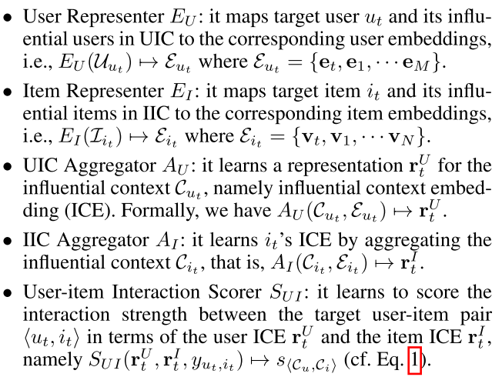
Architecture of modeling HERS

Slide 9

Inﬂuential-Context Aggregation Unit (ICAU)
S1: This stage outputs the subsidiary influence embedding $c_{t}$ through an aggregation function $h\left(⋅\right)$over the influential users' embeddings $e_{k}$:
$$\left\{α_{1},⋯,α_{K}\right\}=a\left(e_{1},⋯,e_{K}\right)$$
$$c_{t}=h\left(e_{1},⋯,e_{K}|α_{1},⋯,α_{K}\right)$$
S2: This stage generates the ICE by aggregating the subsidiary influence context embedding $c_{t}$ and the target embedding $e_{t}$ through a gate function $f\left(⋅\right)$:
$$g=f\left(c_{t},e_{t}\right)$$
$$r_{t}=gc_{t}+\left(1−g\right)e_{t}$$
Notes:
The ICAUs aim to aggregate the user/item embeddings in a context into an ICE according to the strength of influence from each user or item.

Slide 10
Process of user and item ICE aggregation

Slide 11
Outline
Heterogeneous Relations in Recommender Systems
Modeling HERS with Influential Context Units
Experiment Details
Conclusion and Future Direction

Slide 12
Datasets
Two datasets, Delicious and Lastfm provided by RecSys Challenge 2011
https://grouplens.org/datasets/hetrec-2011/

Slide 13
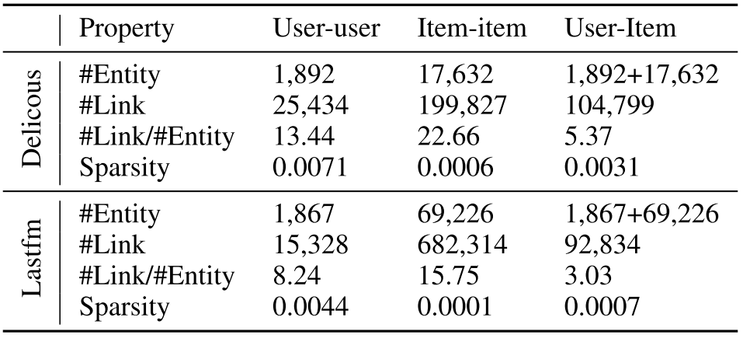
Statistics of datasets: Delicious and Lastfm

Slide 14
Comparison Methods
BPR-MF: it uses the BPR-based optimization on the user-item relation by MF.
SoRec: it jointly factorizes the social-relation matrix and a user-item interaction matrix.
SoicalMF: it adds regularization into MF according to social information.
SoReg: it leverages social relationships to regularize the user's latent factors.
CMF: it is adopted to co-factorize the user-user, user-item and item-item relations.
FM: it embeds features into a latent space and models the interactions between each pair of features. We integrate user-user, user-item, item-item relations as the features.
NFM: a deep neural network-based FM with multiple hidden layers to learn non-linear interactions.
ICAU-HERS: ICAU-based HERS proposed in this paper.

Slide 15
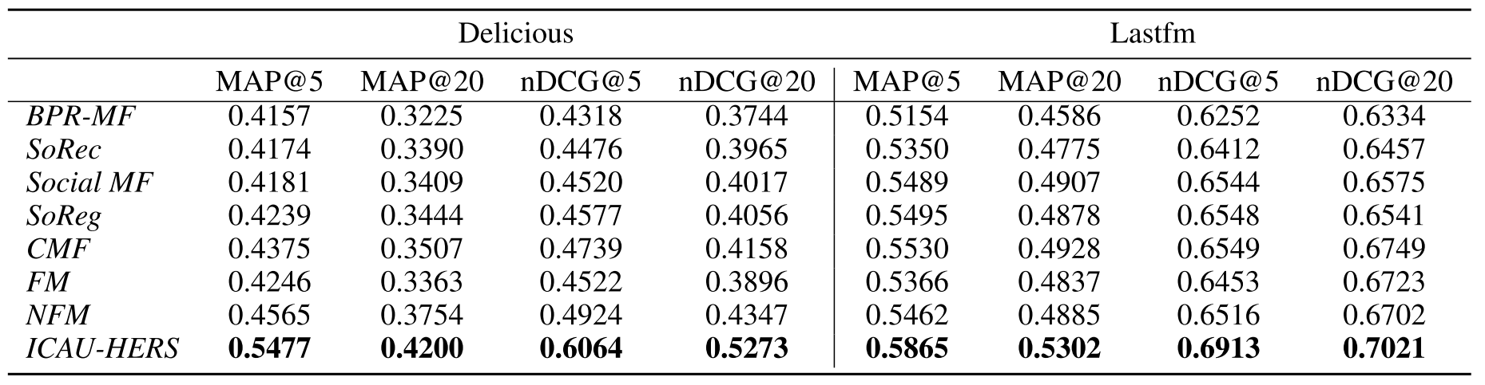
Recommendation accuracy
Notes:
We construct the testing set by holding out 20% user-item interactions as the ground truth.
For each hold-out test sample in the testing sets, we randomly draw 10 noisy samples to test whether the testing methods can successfully rank the true test sample at a top position out of the noisy samples.

Slide 16
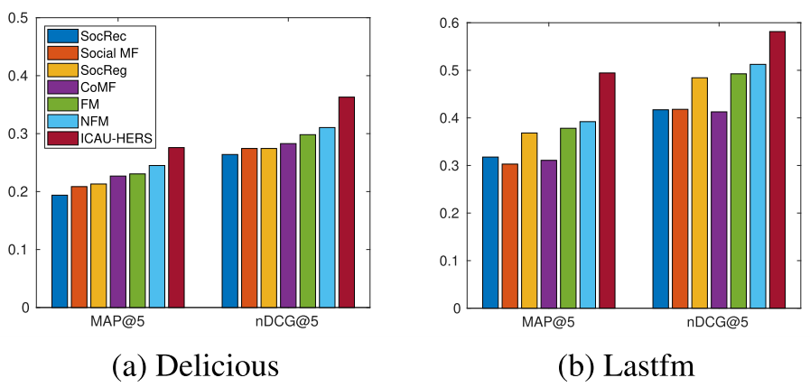
Item recommendation for cold-start users

Slide 17
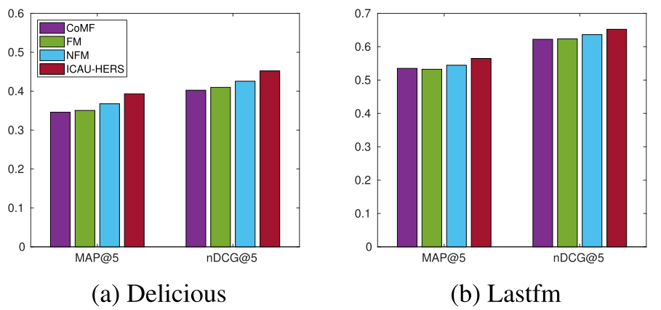
User recommendation for cold-start items

Slide 18
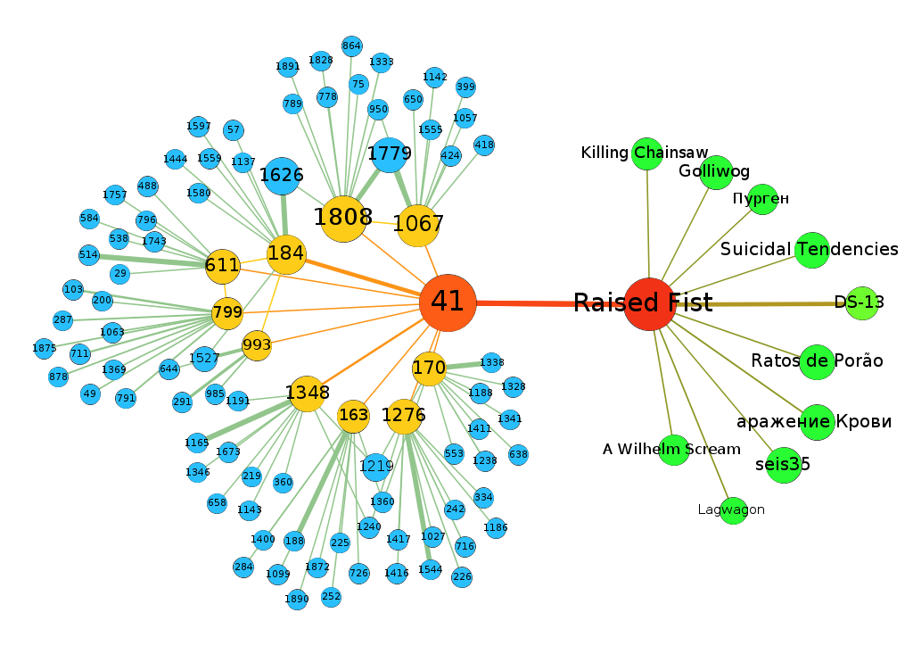
Visualization and Interpretation
The artists in the item network are labeled by their names.
The anonymous users in the user network are labeled with their IDs.
The thickness of edges specifies the significance of influence.

Slide 19
Outline
Heterogeneous Relations in Recommender Systems
Modeling HERS with Influential Context Units
Experiment Details
Conclusion and Future Direction

Slide 20
Conclusion
We propose a framework for modeling influential contexts in recommender systems with the user-user, the item-item and the user-item relations
We implement a neural ICAU-based HERS model. In particular, this HERS can effectively learn the ICEs from user's and item's influential contexts through ICAU.
Extensive experiments show that ICAU-HERS outperforms other state-of-the-art methods and it is effective for handling the user/item cold-start and sparsity problems.
We demonstrate the interpretability of ICAU-HERS with a real case study

Slide 21
Future directions
Apart from recommender systems, ICAU is a general influence embedding model which can be applied to other domains with heterogeneous networks, such as user group behavior analysis and biological interaction network.
It is easy to incorporate content information of each entity to better interpret the influence propagation.

Slide 22
Question?

